Slide 1
Video Game Analysis & Technical Design
  Ch.2 The Design Process & Rules of Play

Slide 2

The Player-Centric Approach
Take the viewpoint of the player during design:
  Entertain them
  Empathize with them
  Become another person
Don’t create a game you would like to play, or focus on creating challenges that prevent the player from winning the game

Slide 3
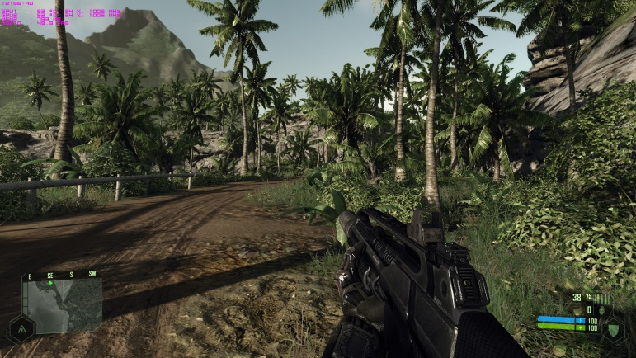
Other Motivations That Influence Design
Market-driven games (get the widest audience!)
Designer-driven games (no other input allowed)
Games for a specific license
Art-driven games (check out my art)
Technology-driven games (check out my engine)
  e.g. Crysis

Slide 4
What to do when designing:
  Have a specific vision
  Consider the audience’s preferences
  Understand licensing benefits and exploit them to the game’s best advantage
  Understand the capabilities of the technology
  Consider aesthetic style
  Take the best from every source
  If a feature is not needed, don’t keep it

Slide 5
Core Mechanics
Generate the gameplay
  Define the challenges
  Define the actions
  Define the player’s effect on the game world
Determine how realistic the game world seems to the player

Slide 6
User Interface
Mediates between the core mechanics & player
  Interprets player input & displays results of input
  Also called the presentation layer (presents the game world to the player) = user experience (be consistent)
  Includes artwork and audio effects
Interaction model
    Avatar-based—through a character in the world
    Multipresent—the player can act on many places at once
Perspective (1st person / 3rd person / aerial)
  Player’s point of view or camera angle

Slide 7
Gameplay Modes
Consist of the available gameplay and user interface at a specific time
  Not all actions are available at all times
  Available user interface choices should be related to the current actions
Only one gameplay mode is available at a time
Use common sense to dictate which actions should be available at a particular time

Slide 8
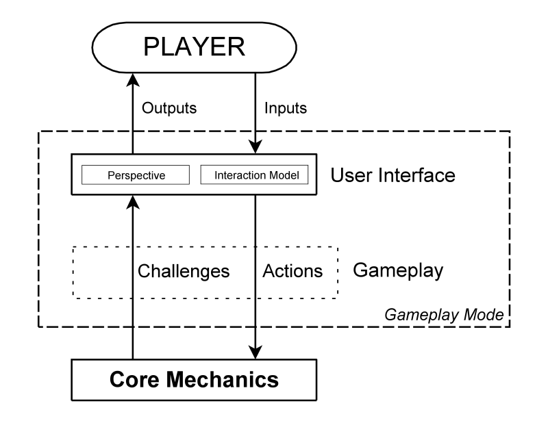
The Gameplay Mode

Slide 9
Shell Menus
Shell menus are used when the player is NOT in a gameplay mode
  The player can’t affect the game world
  The player can save or load a game, adjust the hardware, etc.

Slide 10
Forming the Structure
Gameplay modes + shell menus = structure
The game switches between gameplay modes as required:
  In response to specific player requests
  In response to events in the game

Slide 11
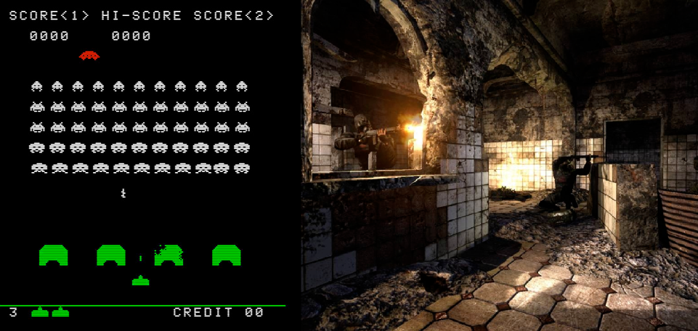
What Is a Game World?
Imaginary place where the game events occur
  Presented by images and sounds
  Not all games have a game world
  A game world can have a culture, an aesthetic, a set of moral values, and other dimensions

Slide 12
Dimensions of a Game World
Physical (2D/3D, scale, boundaries)
Temporal (how time is treated in the game)
  variable time (runs faster than real time)
  anomalous time (runs at different speeds simultaneously in different parts of the game)
Environmental (visual art, audio – details!!!)
Cultural (beliefs, norms)
Emotional (challenges, interactions, music)
Ethical (good/evil, right/wrong)

Slide 13
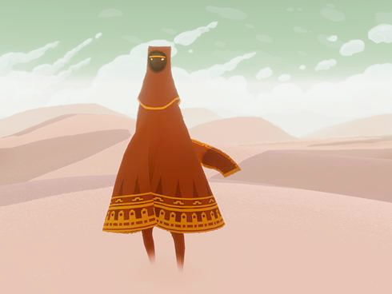
Realism & Attributes:
Realism: all games require some simplification
Functional attributes affect gameplay
  Characterization attributes (fundamental aspects that change slowly or not at all – can be earned)
  Status attributes (change frequently)
Cosmetic attributes do not affect gameplay
  Clothing, gear, facial features, etc.
  Customizing avatar = self-defining play

Slide 14
Play
Creative play allows players to save and reload creations
  Constrained (limited by rules, economy, etc.)
  Freeform (no limitations, more time, fewer rewards)
Storytelling play allows players to create and share stories

Slide 15
Mods, editors & bots
Mods
  Pros (popular with hardcore gamers, extends the lifespan of a game)
  Cons (no control over mod, reputation at risk?)
Level editors
  Players can create new worlds & challenges, but tools must be included with the game
Bots
  AI opponents that the player can program

Slide 16
Stages of the Design Process
Concept/Brainstorming stage (RFP)
  Game concept & audience (should not change after)
  Where to get an idea?
Elaboration stage (GDD → TDD/ADD)
  Primary game mode, the player’s role, game world, core mechanics, story, etc.
  Build the first playable level & playtest
Tuning stage
  Feature lock, minor changes only, get rid of things that don’t work!

Slide 17
Stuff to include in a game concept:
  High concept statement
  Player’s role in the game
  Proposed primary gameplay mode
  Genre
  Target audience
  Hardware platform
  Licenses
  Competition modes
  General summary of progression
  Short description of the game world
  Key characters, if any

Slide 18
Players buy a genre because they like a particular type of challenge
Physical Challenges
  → Action / Shmup games
Strategic, Tactical, and Logistical Challenges
  → Strategy games
Tactical, Logistical, Exploration, and Economic Challenges
  → Role-playing games
Physical and Tactical Challenges
  → Real-world simulations (sports games and vehicle simulations)

Slide 19
Players buy a genre because they like a particular type of challenge
Economic and conceptual challenges
  → Construction and management games
Exploration and puzzle-solving challenges
  → Adventure games
Logic and conceptual challenges
  → Puzzle games
LET’S CHANGE IT UP!
  → Hybrid genres….

Slide 20
Defining Your Target Audience
Who will buy the game?
We must label people as best as we can:
  Men/women
  Children/adults
  More specific labels
    Minecraft fans
    Shmup fans
    DOTA2 fans
    Etc.

Slide 21
The Dangers of Binary Thinking
If group A likes a thing, everyone outside that group WON’T like it….
  Don’t stereotype games!
If group A likes a game, making a similar game means that they’ll like it too….
  Remember 1983?

Slide 22
Progression Considerations
Players need to feel they are making progress when playing long games
Progress can be implemented through
  Levels
  Story
  Both

Slide 23
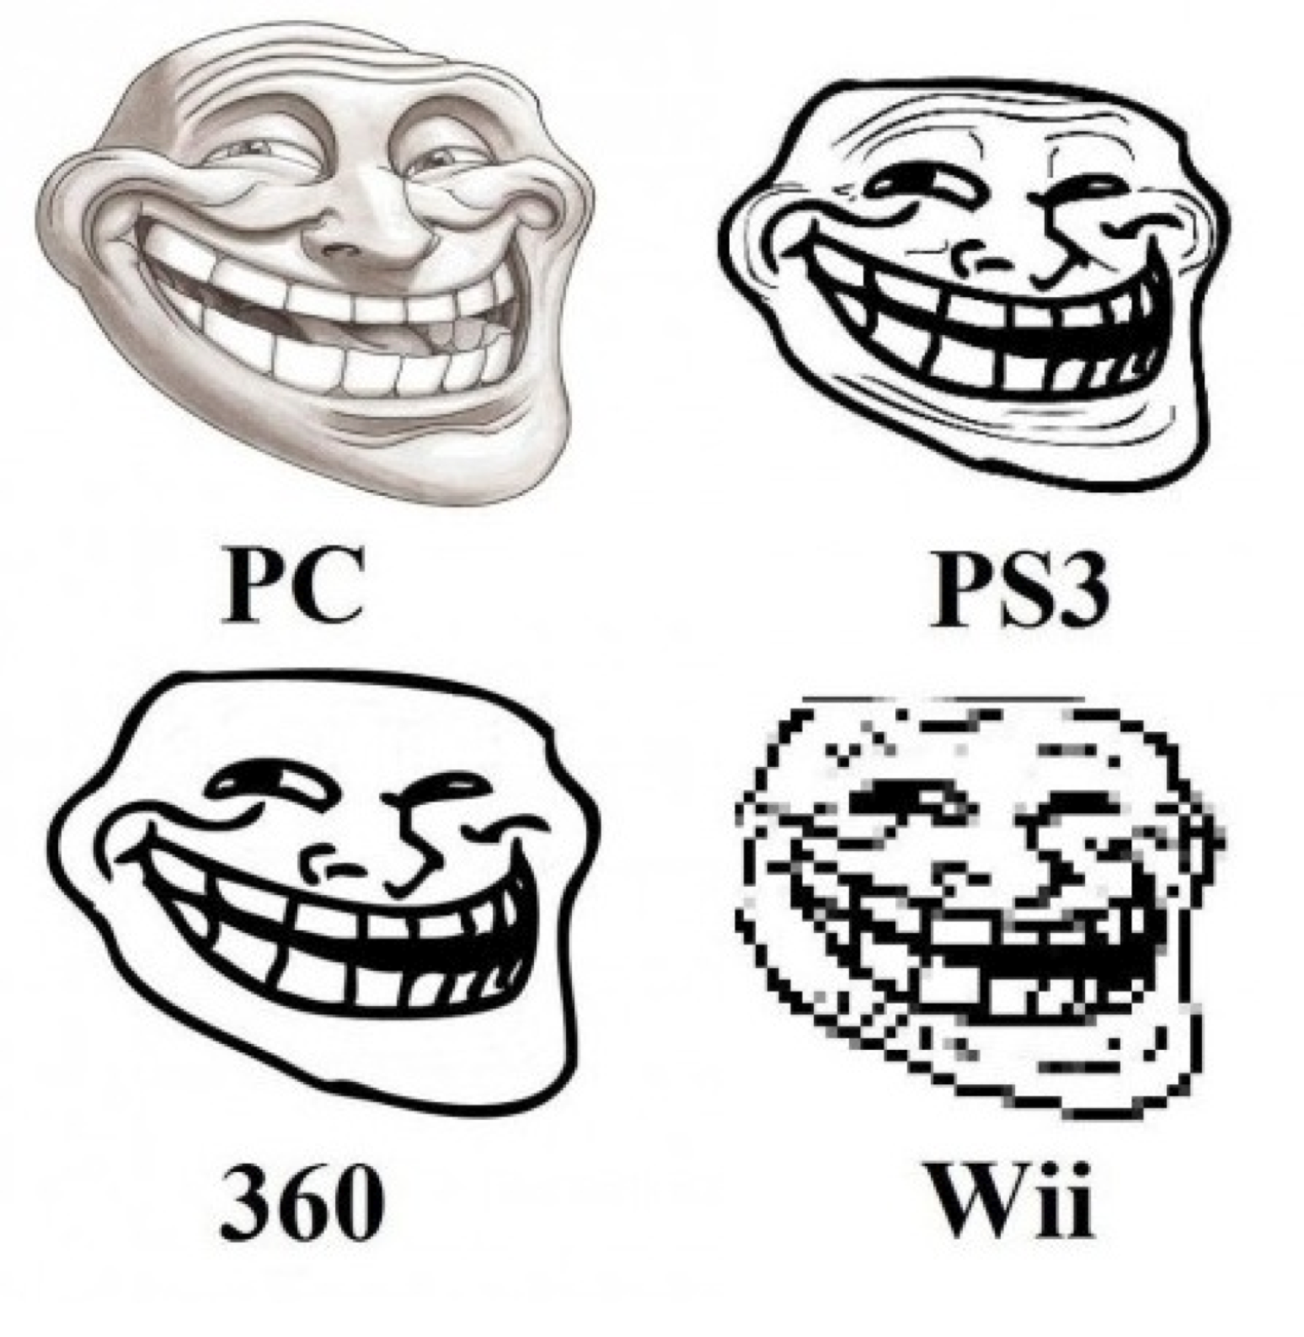
Choosing a Hardware Platform
Home game consoles (standard hardware)
PCs (more hardware)
Mobile phone/tablet (less hardware, used for__)
Handheld console (better than mobile, only for gaming)

Slide 24
Interface Design
Players prefer to use a familiar UI
General principles of interface design:
  Be consistent
  Give good feedback
  Make everything as easy as possible for the player
    Tell the player what he needs to know
    Offer actions the player can perform

Slide 25
Audio Design
Sound effects
Ambient sounds
Music
Dialog and voiceover narration
  Repetition can be irritating
  Create multiple alternative versions

Slide 26
Game World Design Process
Design the gameplay modes
  Primary gameplay mode first, then move on to others
  Define a different user interface for each gameplay mode
    For each mode, design a screen layout, select visual elements, and define inputs
Choose a screen layout
Tell the player what he needs to know
  Select data from core mechanics that you want to show (critical feedback first)

Slide 27
Game World Design Process
Let the player do what she wants to do
  Begin devising appropriate control mechanism for each action the player can take that affects the game
  Create visual and audible feedback for actions
  Map input devices to player’s actions based on chosen interaction model
  Each time you move to new gameplay mode, note the actions it has in common with other modes to keep control mechanisms consistent

